Slide 1
Care Crop
Supervisor Dr. Shaimaa Aly
By
Sarah Mohamed Saad ElMasry
Salma Mohamed Zaki Hafez

Slide 2
Contents
Introduction.
User Interaction.
Technology used.
Conclusion.

Slide 3
Introduction
01

Slide 4

Care Crop is an application program that offers health-related services for smartphones.
Care Crop is designed to help consumers make healthier choices in their everyday life by offering advice about fitness or nutrition.

Slide 5
User Interaction
02

Slide 6
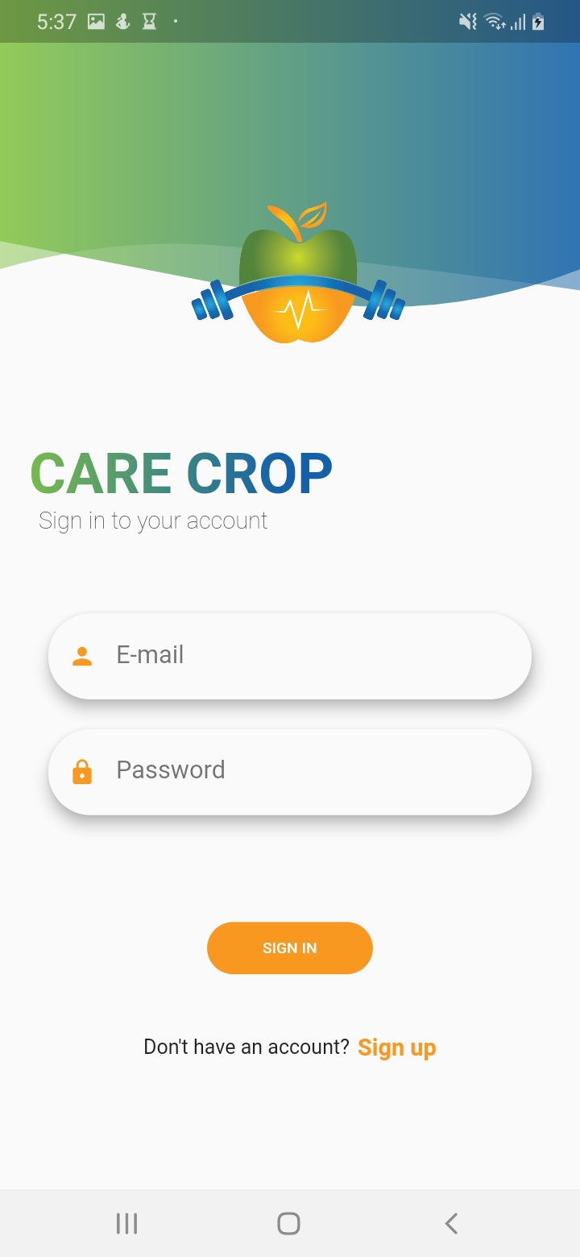
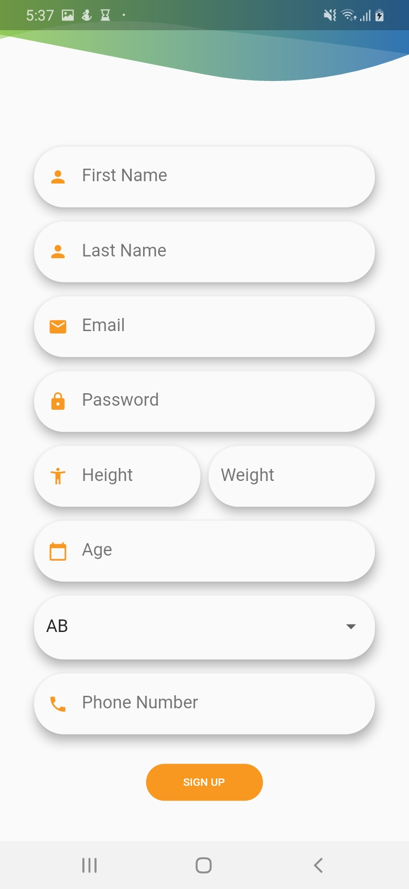

Slide 7
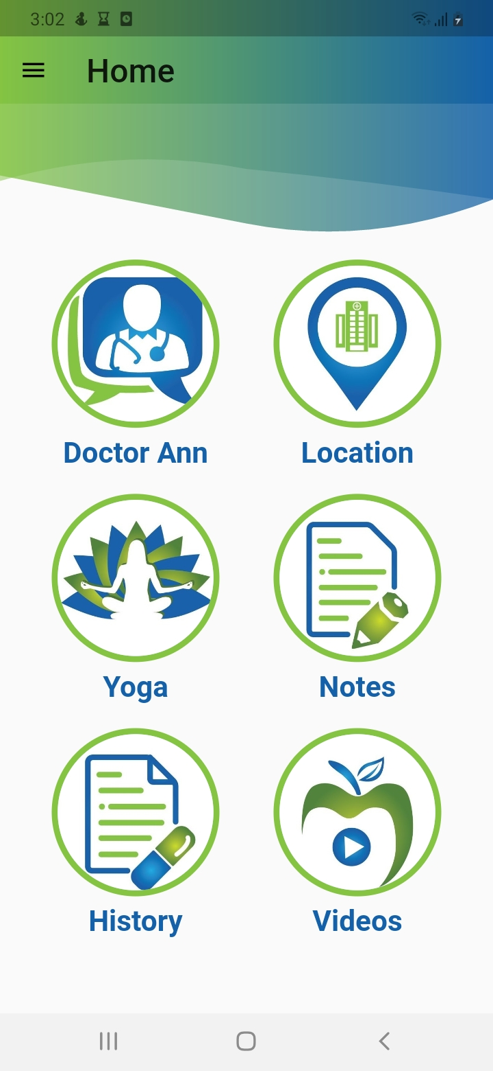
Care Crop application provide 6 core different medical services

Slide 8
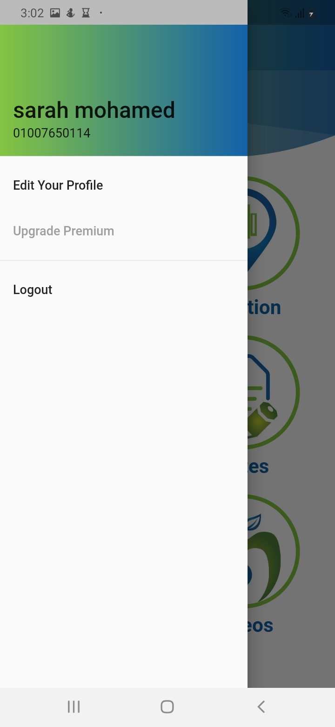
Home Side Menu:
Display user name and phone number
settings menu
Upgrade premium (Disabled for now)
Logout function button

Slide 9
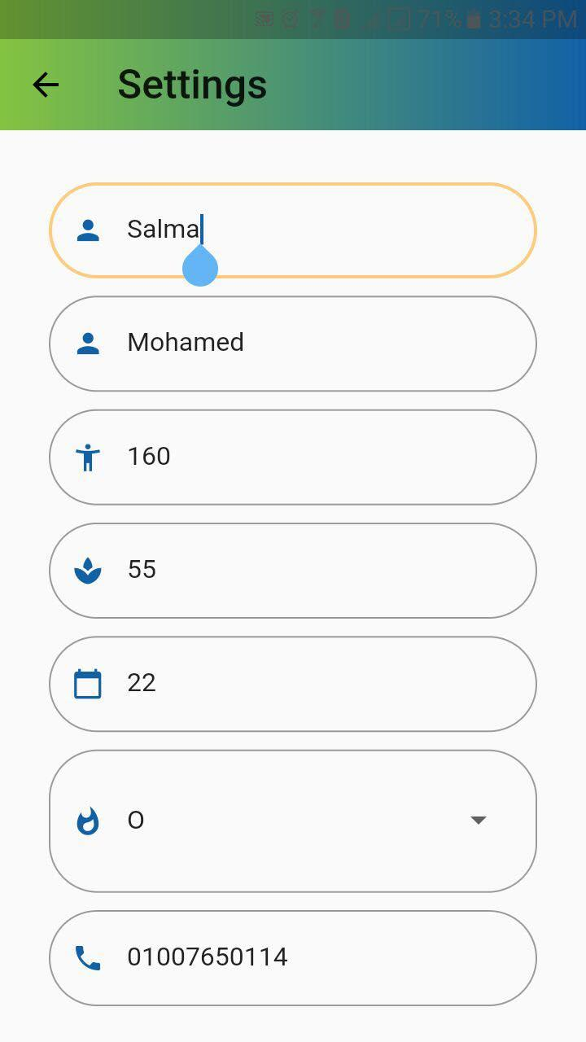

Slide 10
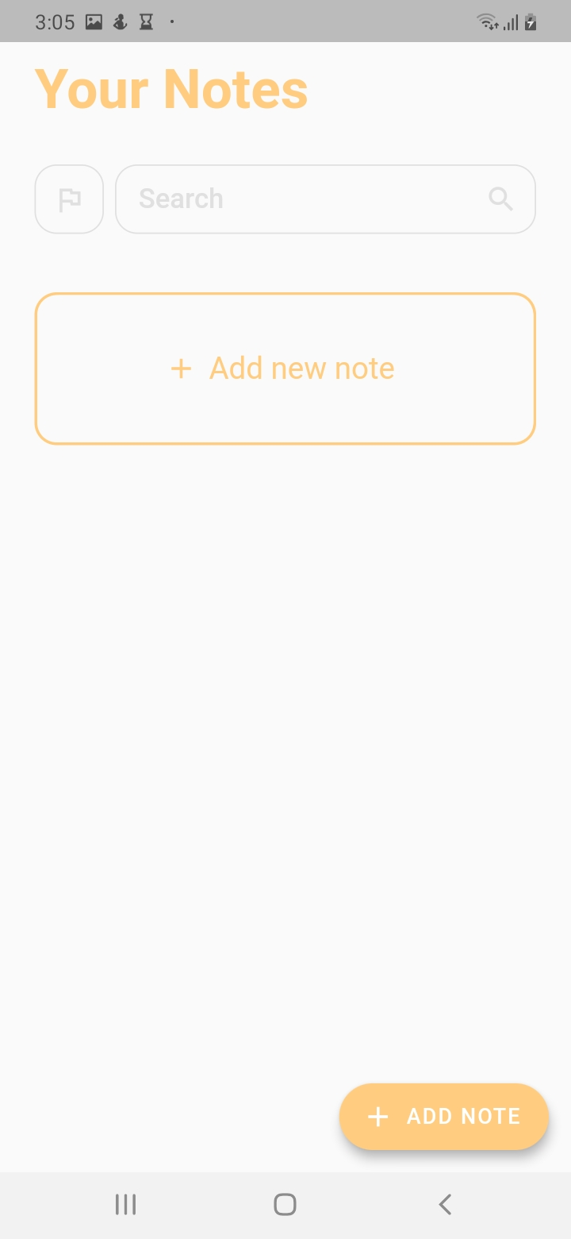
Notes Section
Now you can store your medical notes in a fast and easy way.

Slide 11
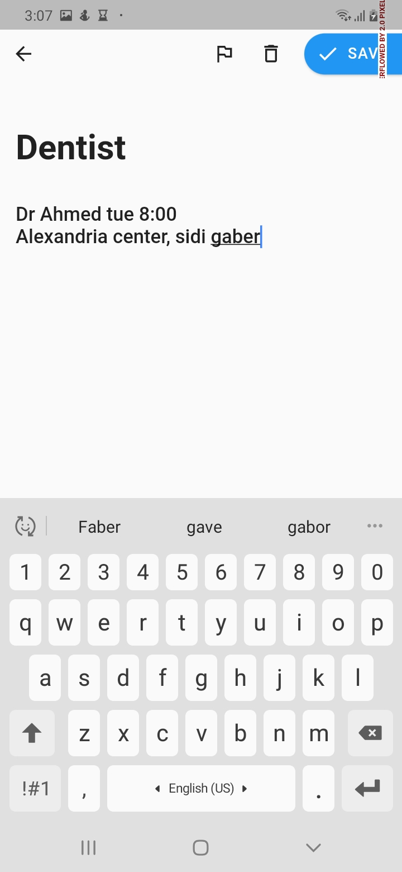
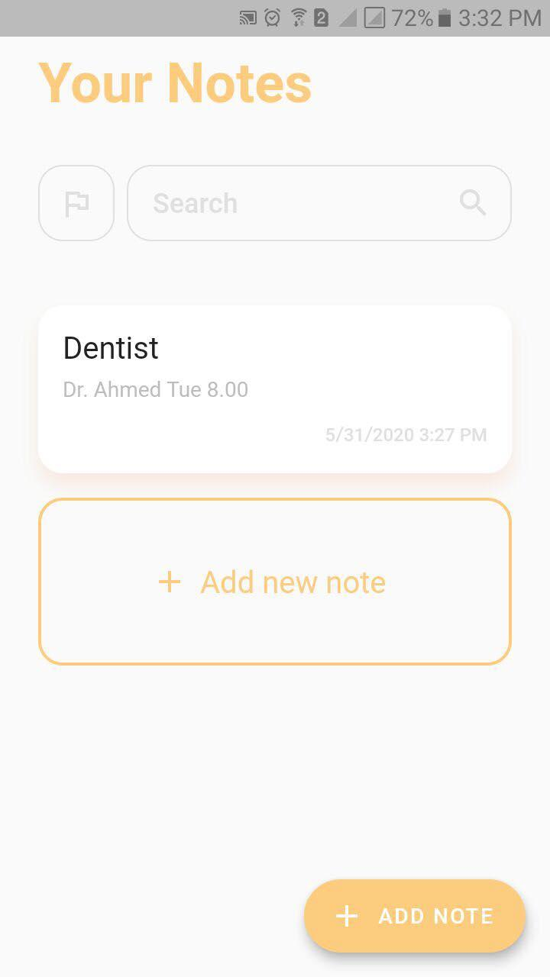

Slide 12
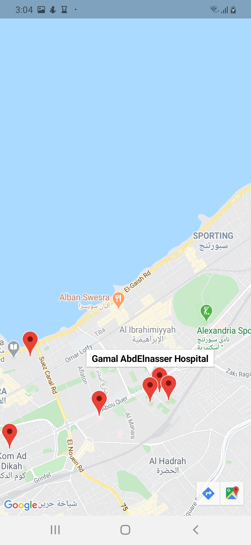
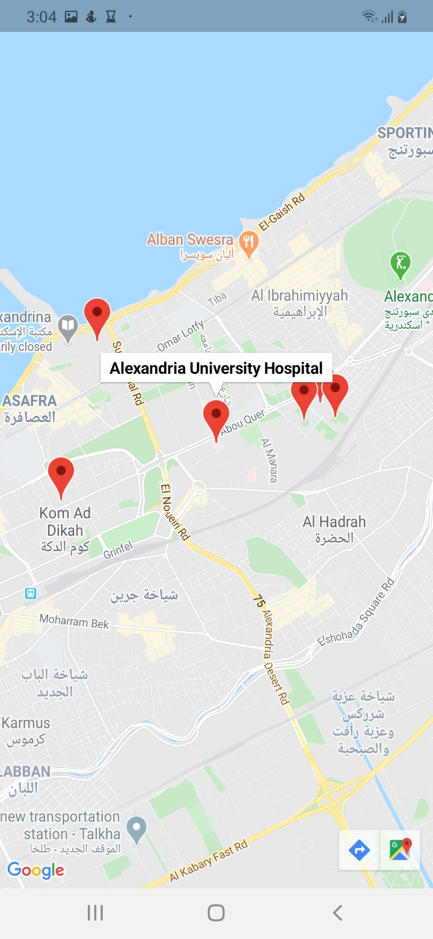
Here
You
Are

Slide 13
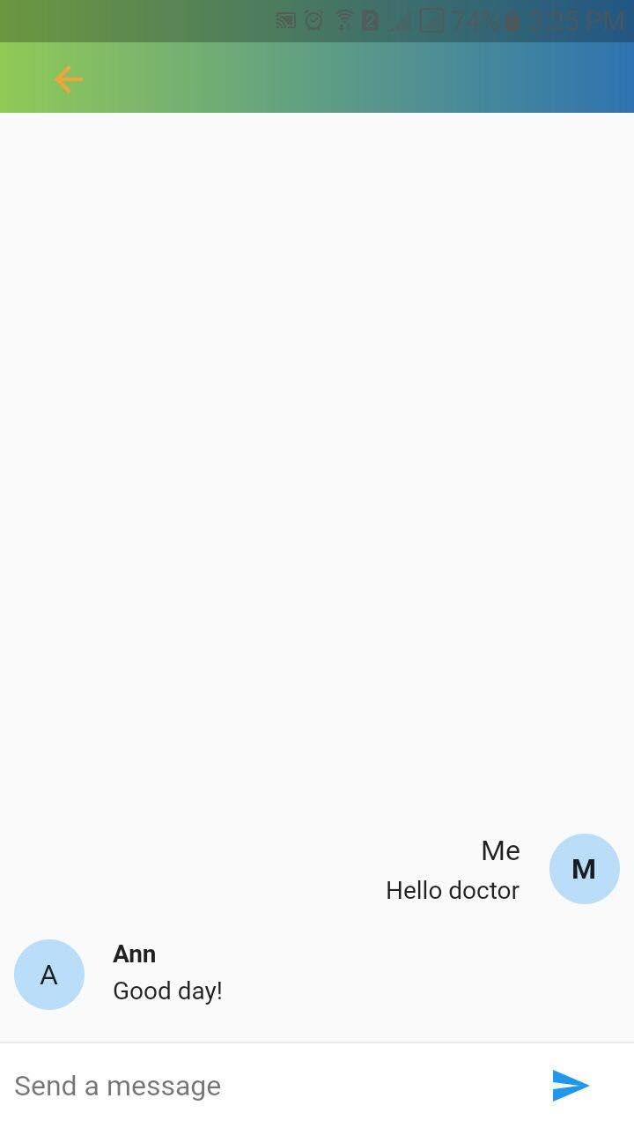
Doctor Ann

Slide 14
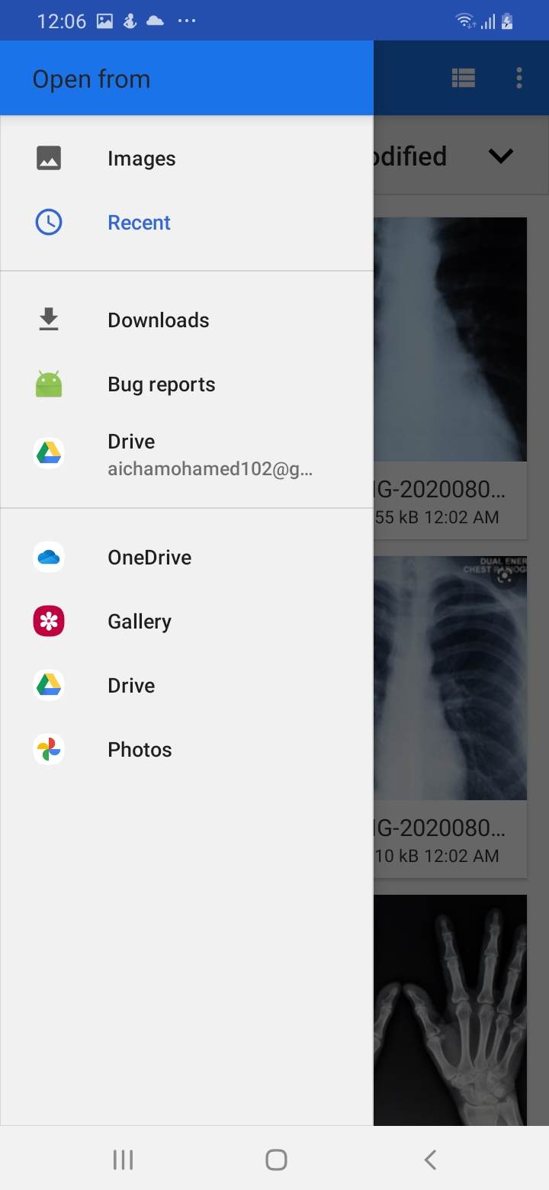
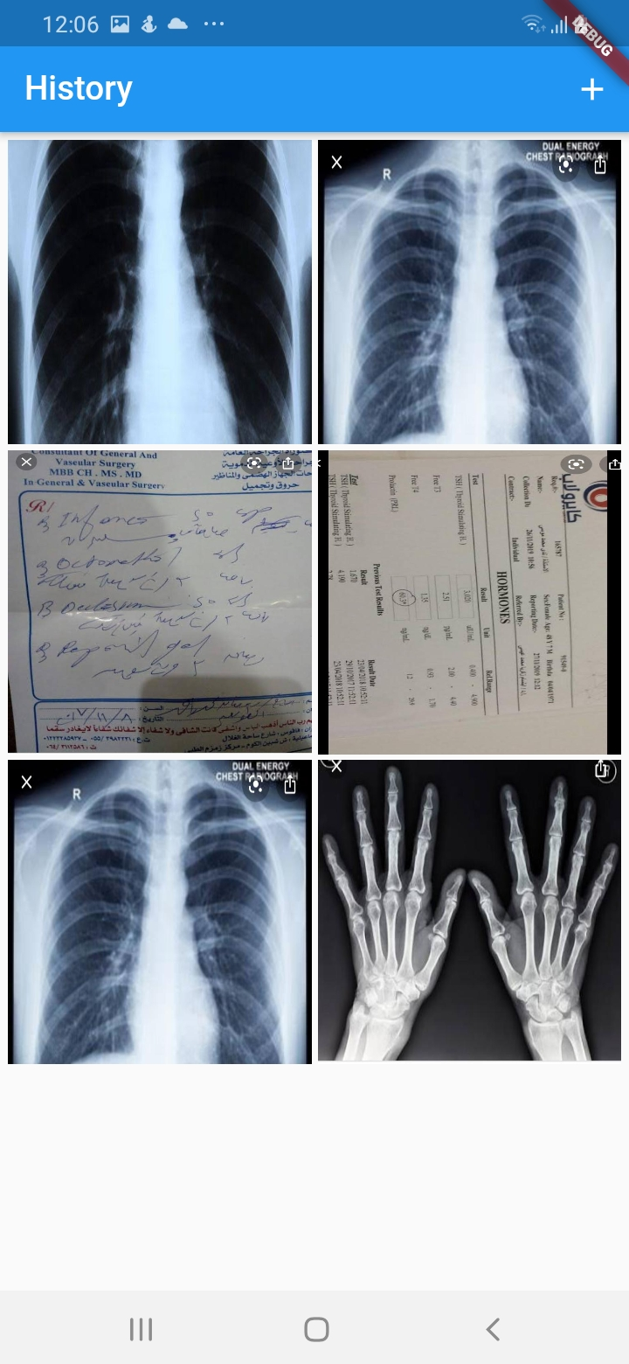
History Section
Now all your medical reports are one-step far from you!

Slide 15
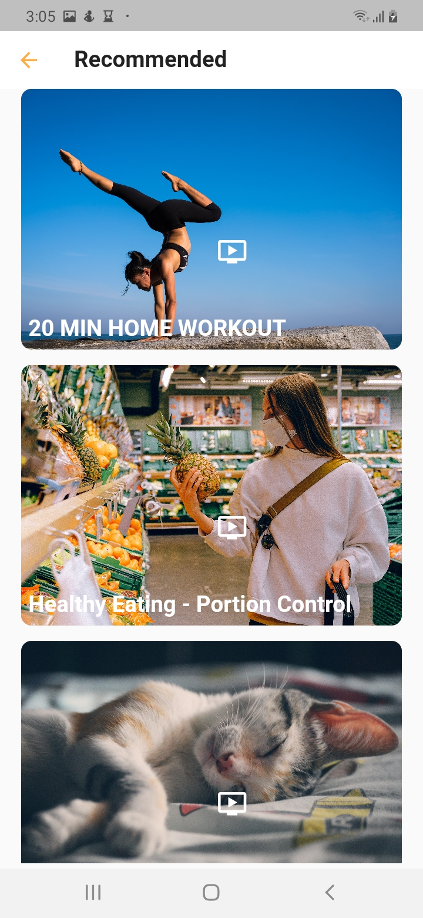
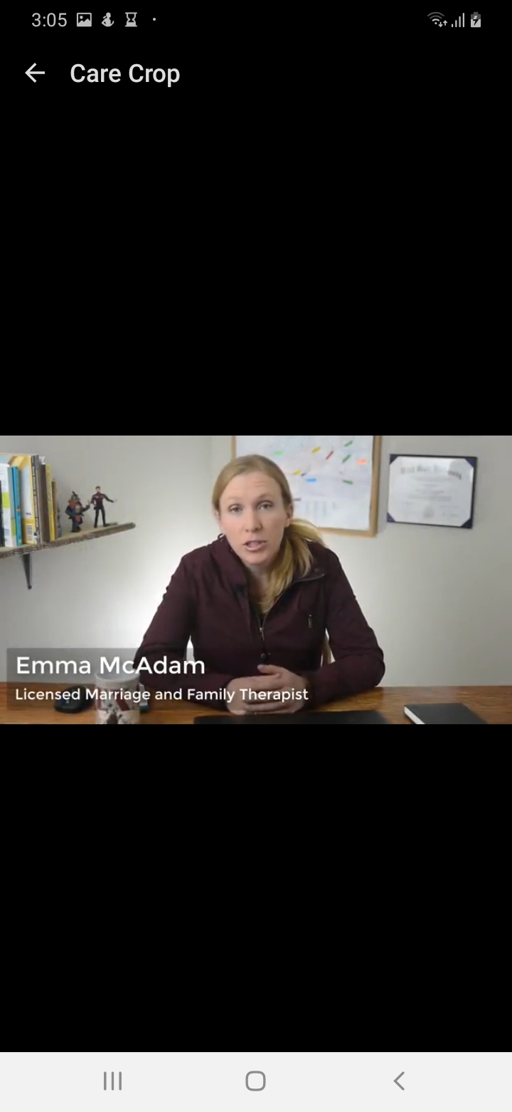
Youtube
Section

Slide 16
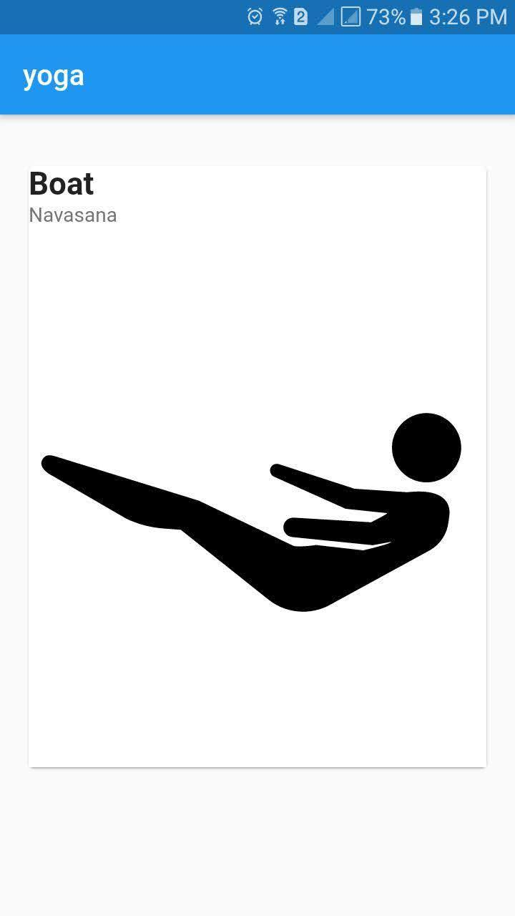
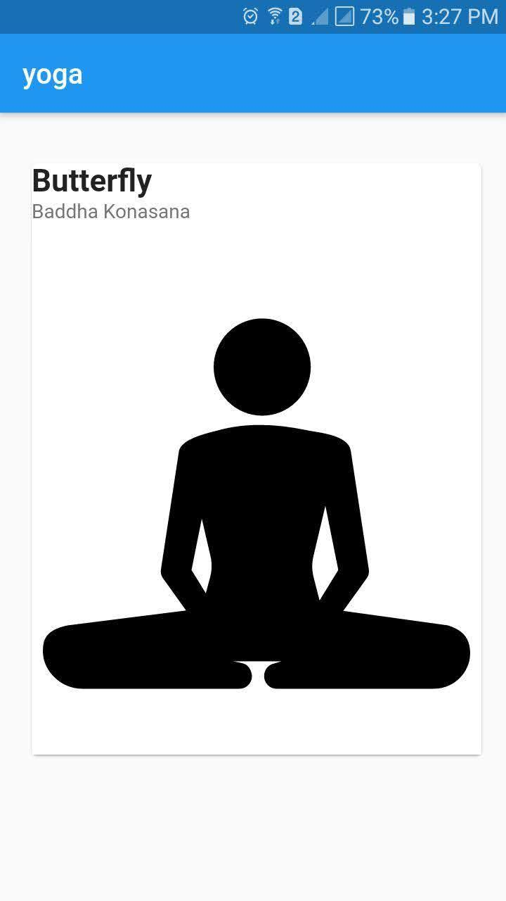
Yoga
Keep calm and enjoy doing simple activities during staying at home.

Slide 17
03
Technology Used

Slide 18
Flutter
Flutter is a free and open-source mobile UI framework created by Google and released in May 2017.
It allows you to create a native mobile application with only one codebase.
This means that you can use one programming language and one codebase to create two different apps (for iOS and Android).

Slide 19
What makes flutter unique?
Cross platform
Single code
Compiles to binary code
Hot reload
Fast performance
Flexible UI

Slide 20
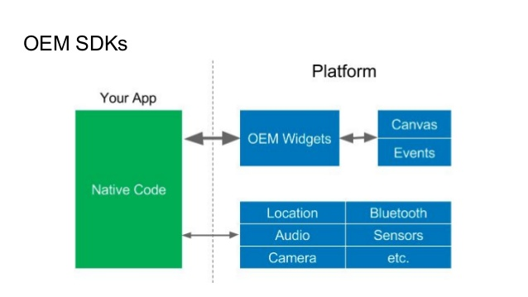

Slide 21
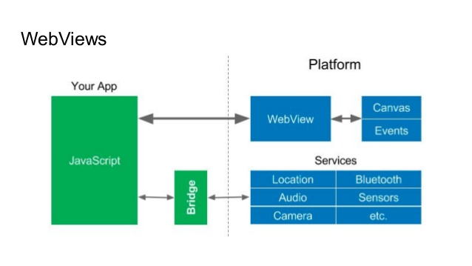

Slide 22
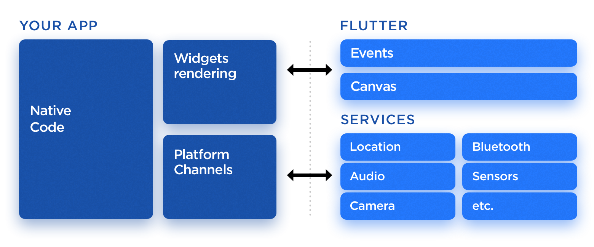

Slide 23
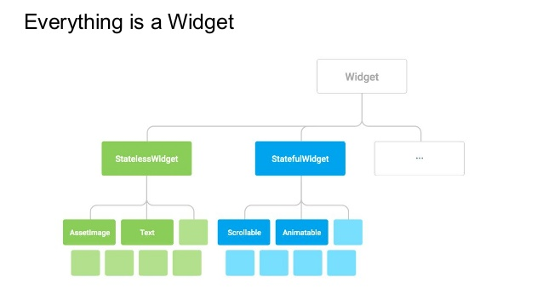
How Flutter works?

Slide 24
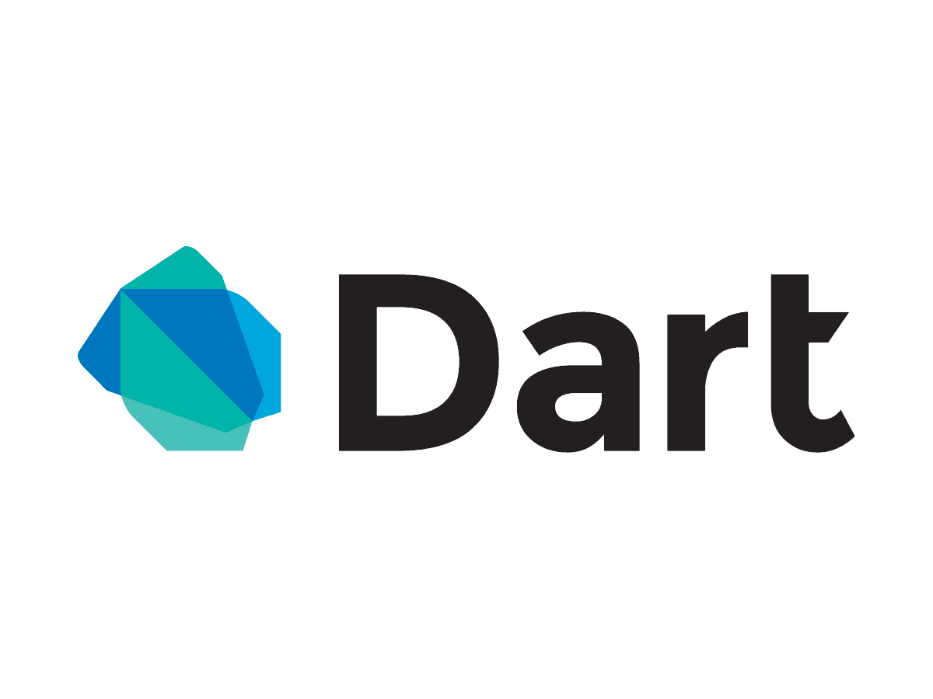
What language is flutter built with?

Slide 25
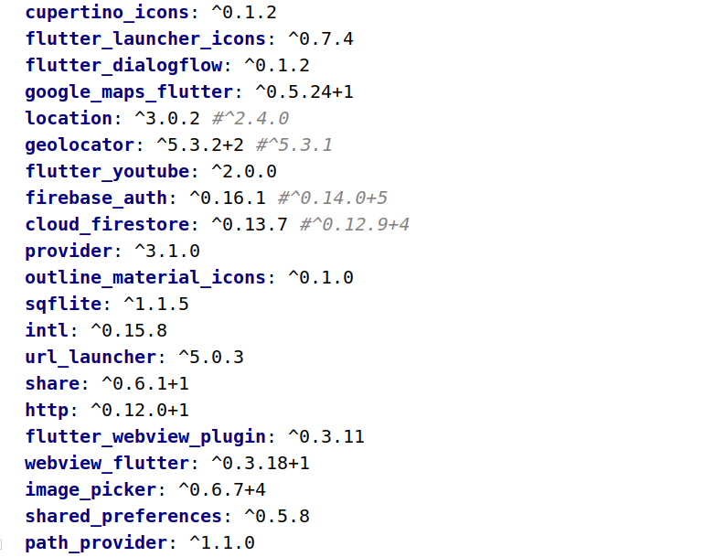
Packages used

Slide 26
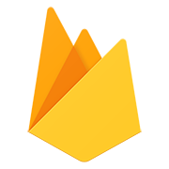
2. FireBase
Firebase manages all data real-time in the database. So, the exchange of data to and fro from the database is easy and quick..
Firebase allow syncing the real-time data across all the devices- Android, iOS, and the web without refreshing the screen
Firebase offers integration to Google Ads, AdMob, DoubleClick, Play Store, Data Studio, BigQuery, and Slack.
Everything from databases, analytics to crashing reports are included in Firebase. So, the app development teams can stay focused on improving the user experience

Slide 27
Why Firebase?
Create Application without backend server
No SQL database so it is more faster
Push notification
Analytics
Crash reports
Cloud storage
Test Lab
Auto Backup

Slide 28
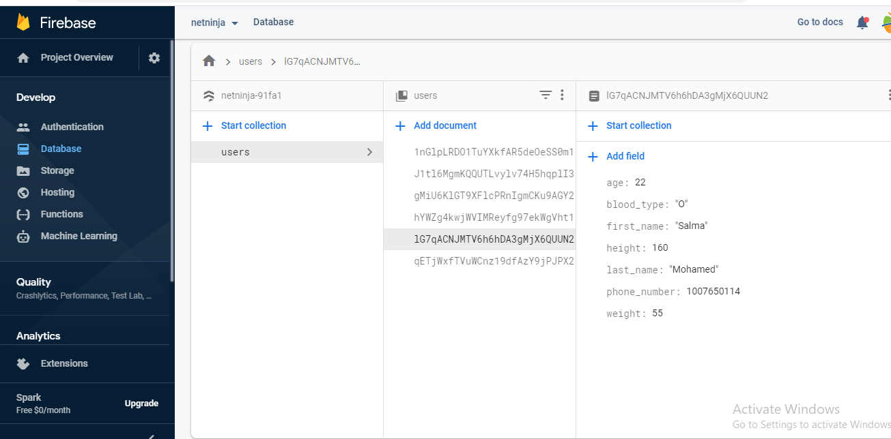

Slide 29

3. DialogFlow
Dialogflow is a natural language processing (NLP) platform that can be used to build conversational applications and experiences for a company’s customers in various languages and on multiple platforms.
The Google-powered product enables developers to create interfaces for responding to customer queries in different languages.

Slide 30
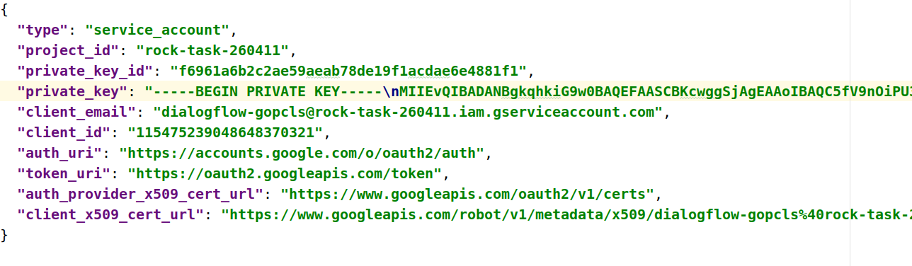
Dialogflow JSON
Notes:
1.cloud
2 . download el json

Slide 31
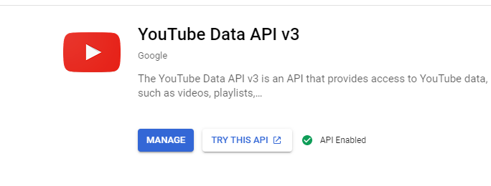
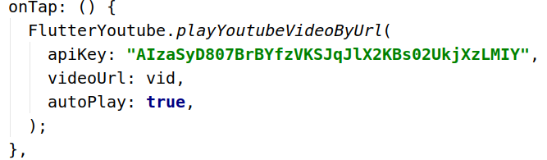
4. Youtube API

Slide 32
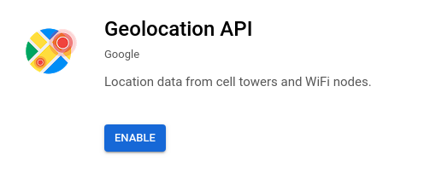
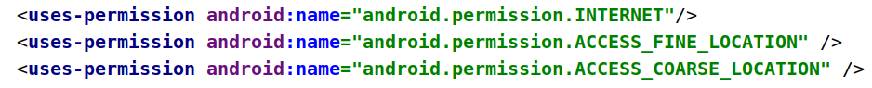
Google map

Slide 33
Application Video

Slide 34
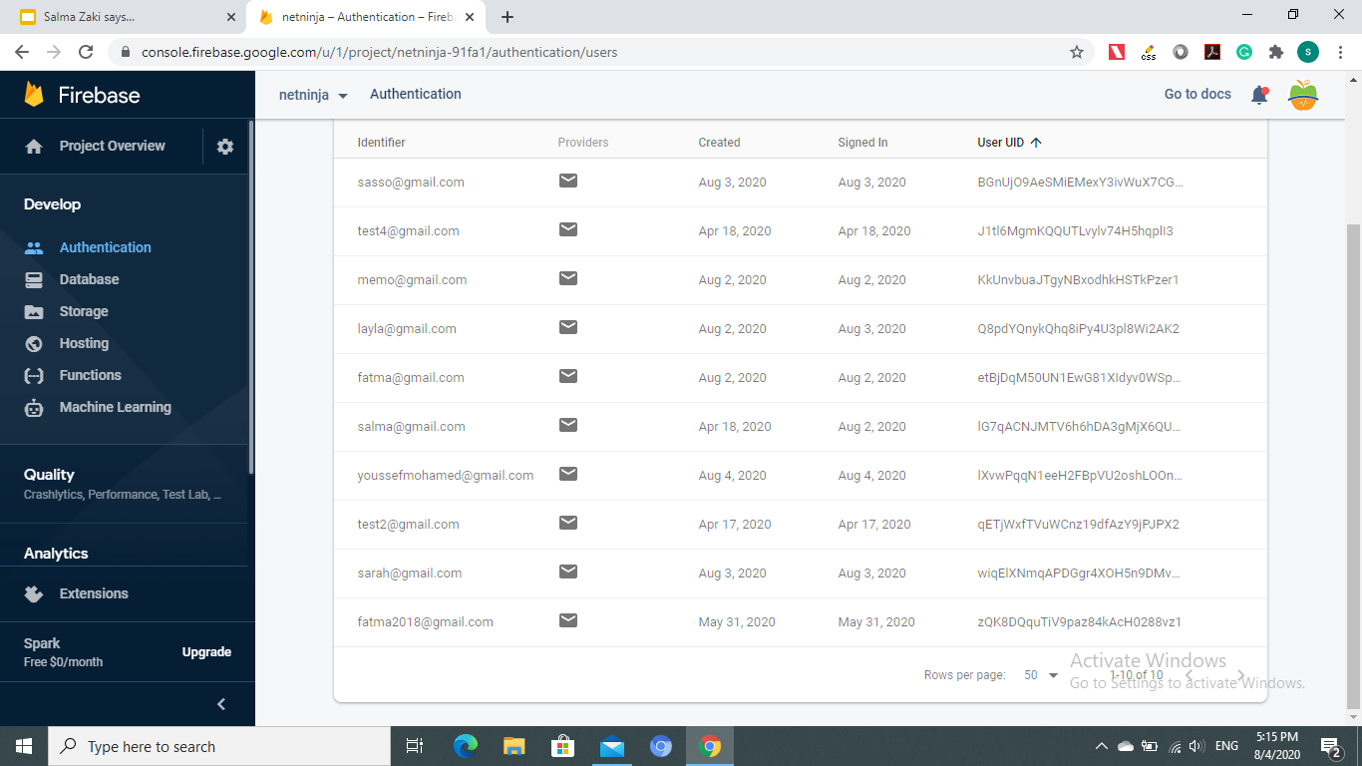

Slide 35
Thanks!

